Slide 1
Improved Measures of ICT in the US National Accounts
Dave Wasshausen
Fifth World KLEMS Conference
June 4-5, 2018
Cambridge, MA

Slide 2
BEAs Digital Economy Initiative
BEA is studying new data sources to improve the way we measure digital goods and services in the National Accounts
Price indexes are an important piece of that
Custom & own-account software
Electro-medical equipment
Cell phones
Accurate nominal measures are also important(!)
Cloud computing
Software

Slide 3
Software Prices
Packaged software PPI
Carrying back improvement introduced in last years AU
Custom and own-account currently reflect an input-cost based price index
Input-cost uses domestic wages for software developers
Goal of our ongoing research some combination of:
Output price index based on function points
Other analysis to inform our current method (e.g. a productivity adjustment)

Slide 4
Why (or Why Not) Function Points?
“Function points are used to compute a functional size measurement (FSM) of software.” (Wikipedia)
Pros
Generally accepted metric in the industry
The only metric that we’ve been able to identify
Cons
Not necessarily homogenous
More not necessarily better
FP databases are not representative samples

Slide 5
Function Points Database

Slide 6
Justification for Use of Hedonics
Heterogeneity in P/FP across projects suggests FPs depend on a lot of things
Use hedonic regression to control for some of these factors:
Client & Client Industry
Project Type & Size
Maturity of Firm
Others……

Slide 7
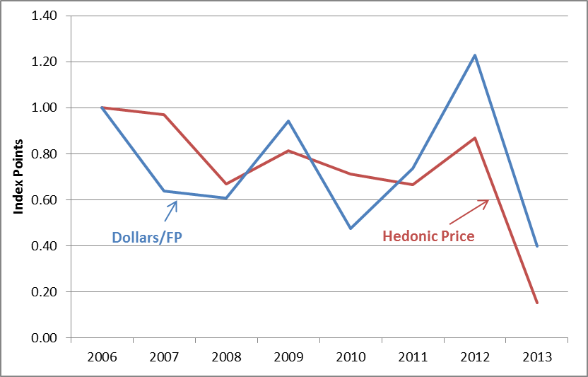
Software Price Indexes

Slide 8
Cell Phones Prices

Slide 9
Cell Phones Prices Continued
Newly available QA price indexes introduced by the Federal Reserve Board
BEA first introduced FRB price indexes for communications equipment in 2010
BLS CPI introduced new hedonic-based quality adjustment for smart phones in January 2018
Unfortunately not currently published as it’s own index – part of an aggregate

Slide 10
Byrne, Corrado and Sichel Analysis
Own-Account IT Equipment Investment (FEDS Notes 10/4/2017)
“Why has IT equipment investment been so weak since 2007?”
Financial reports of IT services companies suggest massive increases
Reports may reflect global capital expenditures
Trade off between purchases of IT services vs building own data center
Conclude NIPA private fixed investment likely missing IT
Likely culprit is own-account investment in IT-related hardware (e.g. servers)

Slide 11
Plans for 2018 Comprehensive Update
Agree that Byrne, Corrado and Sichel are on to something
Working collaboratively across directorates, identified additional investment in computer hardware as part of the 2012 benchmarking process
Improved prices for communication equipment which will show more rapid price decline
Identified additional packaged software investment, also as part of the collaborative 2012 benchmarking process
Recorded as receipts for “application services provisioning”

Slide 12
Timeline of the ‘Cloud’
2006: Amazon Web Service, Google Apps Launched
2007: With the launch of the smart phone, everyone has access to the cloud in their pockets.
2010: Cloud takes center stage; Netflix moves into the cloud with AWS
2012: AWS offers 1900 software products, 23 categories, 190 countries

Slide 13
Improved IT Equipment
Reallocating selected imports to final demand
Impacted servers and storage devices
Modifying allocations of domestic supply
From intermediate fixed investment

Slide 14
Missing imports: Reallocating imports of “Other Data Processing Machines” from PCs into Servers .
Conclusion: These imports include servers and incomplete server components that are imported to be assembled by cloud companies into a larger network.

Slide 15
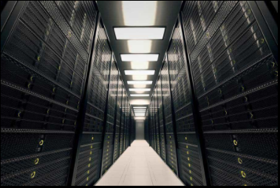
Missing Imports: Justification for the reallocation
Nature of server components makes them hard to classify
Average unit price of $2,014
Supply chain of the harmonized code includes contract original design manufacturers known to work with American hyperscale cloud companies that operate in Mexico

Slide 16
“Missing” Imports
PCs and Computers are in 847130, 847141
Auto Data processing machines not in 847130 and 847141
Other, with $15bn in 2012

Slide 17
Supply Chain of ‘Other Data Processing Units’

Slide 18
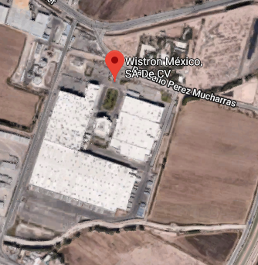
Supply Chain: Wistron
ODMs linked with IT Companies operate Facilities in Mexico, including Wistron, a top importer of the harmonized code in question

Slide 19
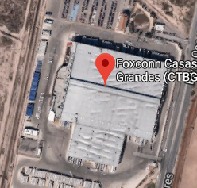
Supply Chain: Foxconn
Foxconn, the world’s largest electronic manufacturing service provider, also makes rack modules for servers

Slide 20
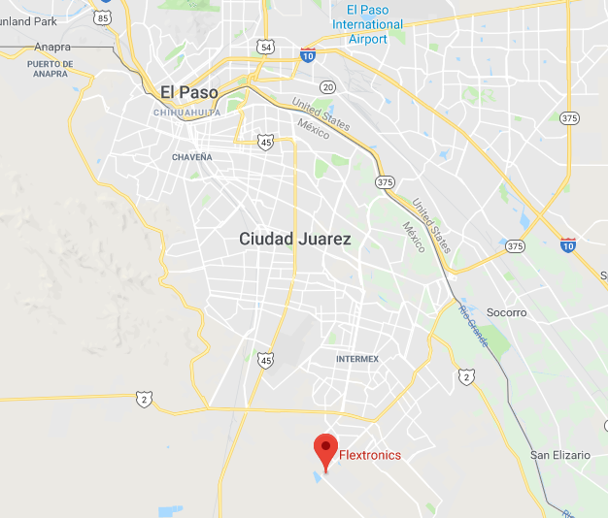
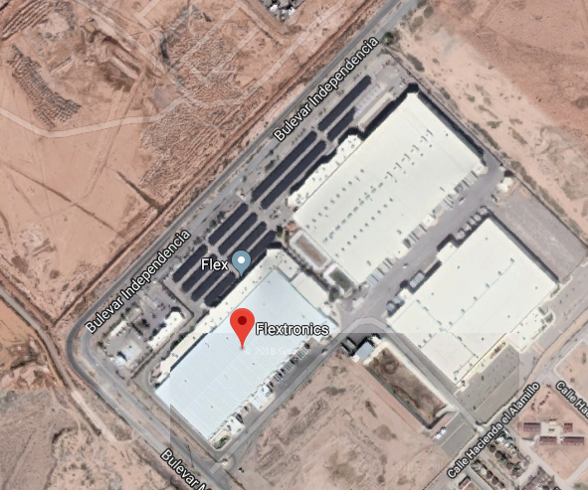
Supply Chain: Flex

Slide 21
Revised PFI Servers Trend

Slide 22
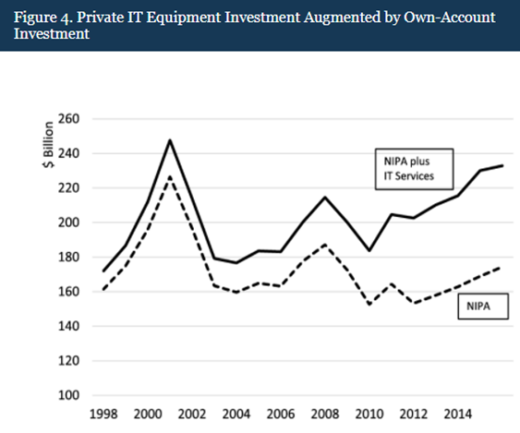
NIPA vs. FEDS Notes

