Slide 1
Literature and medicine
Nina Begus
Harvard University/UW
nbegus@g.harvard..edu

Slide 2
How can humanities be useful for medicine?

Slide 3
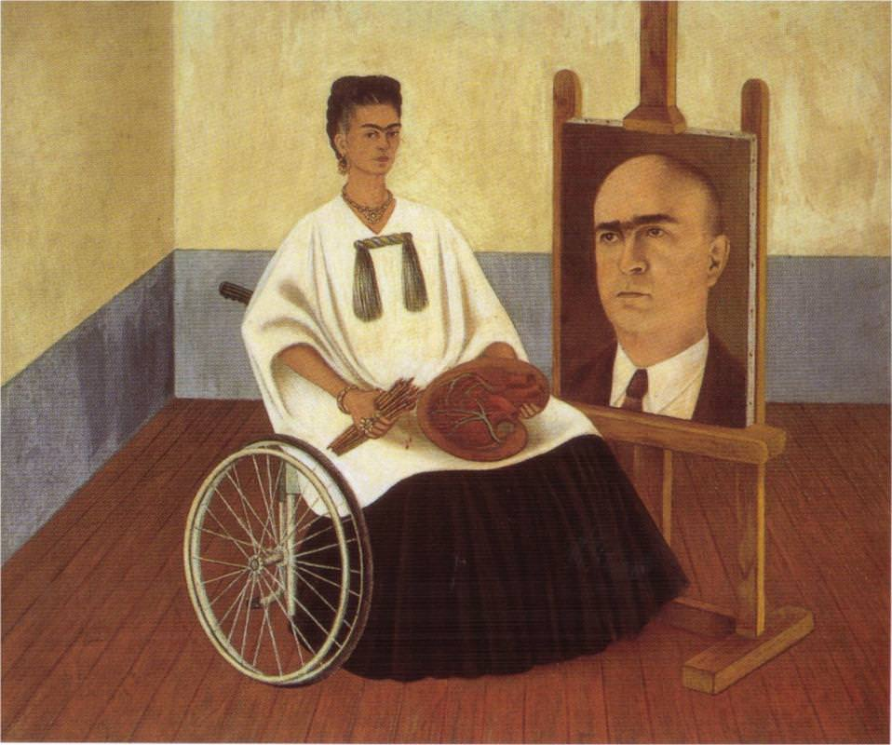
How can humanities be useful for medicine
Medical Humanities/Health Humanities
Arts and Humanities as applied to medical education and practice
- Literature and Medicine
narrative medicine (critical thinking, awareness, healing through art)
- Bioethics
moral values of healthcare (organ donation, new technologies, etc.)
- Clinical Ethics
professionalism in medicine (bedside manner, bias, etc.)
Frida Kahlo, Self-Portrait with the Portrait of Doctor Farill, 1951.

Slide 4
Example of all three Nancy jecker, Caring for ‘Socially Undesirable’ Patients Cambridge Quarterly Healthcare Ethics 5/4 (1996): 519-32
Mr. Bernard was a homeless man, aged 58. His medical history revealed alcohol abuse, seizure disorder, and two suicide attempts. Brought to the emergency room at a local hospital after being found "semi-comatose," his respiratory distress led to his being intubated and placed on a ventilator. The healthcare team suspected the patient ingested antifreeze. […]
The healthcare team discussed placing a DNR [do not resuscitate] order in the patient's chart. Several residents felt that a unilateral decision to withhold resuscitation was justified and that continuing to treat Mr. Bernard was futile. During rounds, a resident stated that "somebody has to make the decision," but no explicit discussion of nonmedical considerations was acknowledged. No DNR order was written prior to the patient's transfer to a general medicine floor. An effort was made to contact some- one from the local Mission (where the patient had stayed) to find out if the patient had any family members. […] The patient's daughter who resided in another state was reached by phone, and agreed to a DNR order based on the attending physician's recommendation.

Slide 5
The following day a medical student asked, "Why should we continue to treat this guy given the quality of life he had before he ever got here?" The student added that the patient was on Medicaid, and perhaps "society could find better ways to spend healthcare dollars." The attending physician responded, "We don't know what this man's life is like. Even if he lives under a bridge, he may help other people who live with him. Although he may be responsible for his condition, a good society is a compassionate and forgiving society." Later, the attending pulled the residents aside and told them they were "doing good" and that there were times when physicians had to make rationing decisions when no one else will or can.
WHAT RAISES CONCERNS?

Slide 6
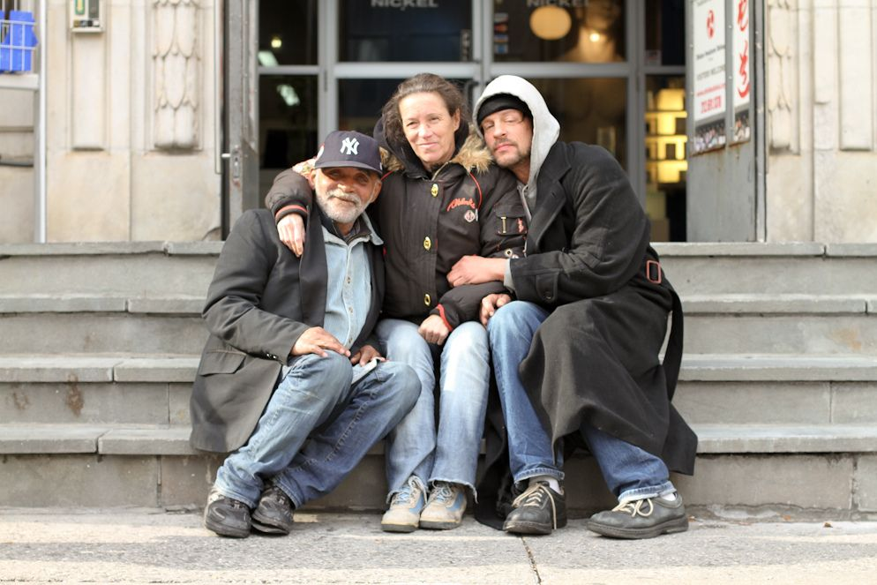
HONY!
"Why are you photographing homeless people?"
"I'm not. I'm photographing friendship."

Slide 7
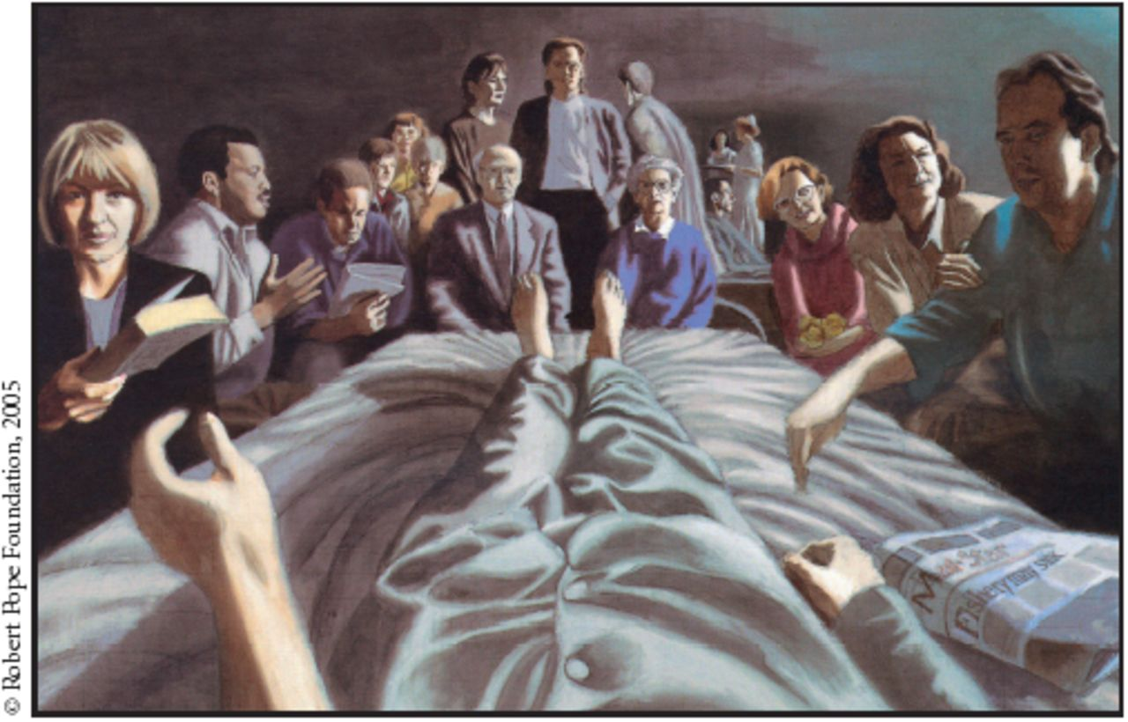
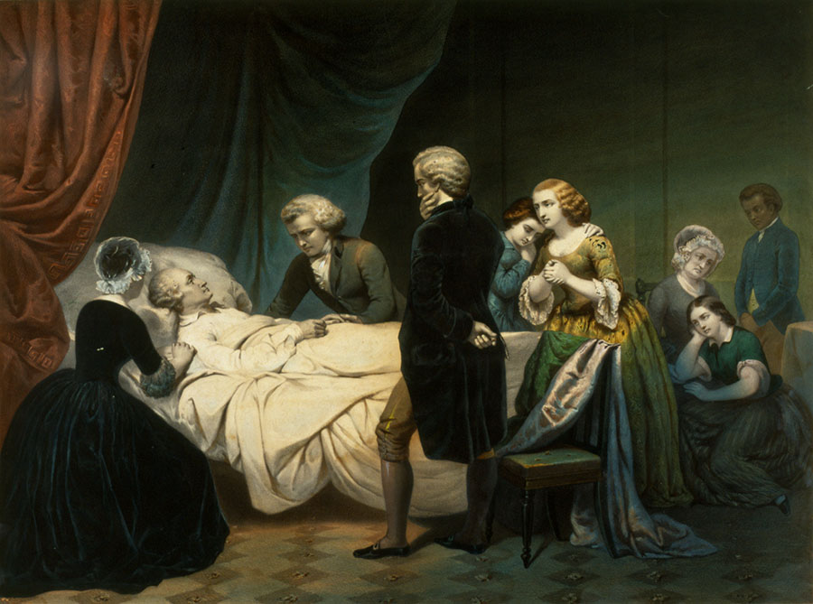
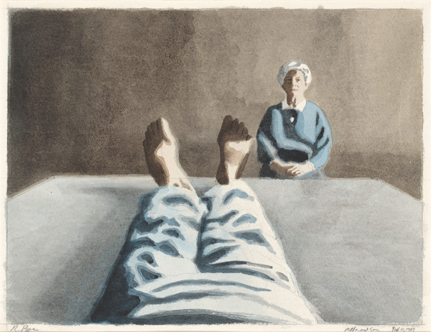
why are stories important?
Robert Pope,
Visitors, 1989.
Mother and Son,
1989.
Life of George Washington: The Christian, lithograph by Claude Regnier, after Junius Brutus Stearns,1853.

Slide 8
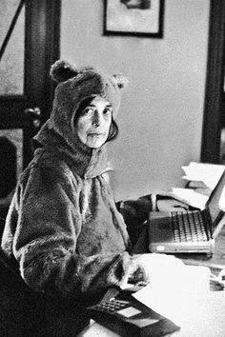
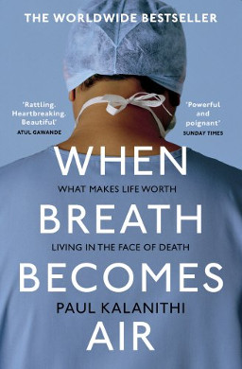
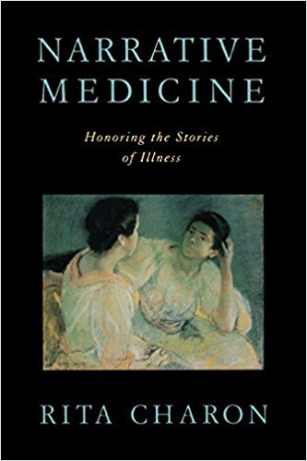
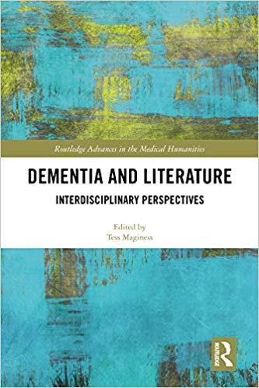
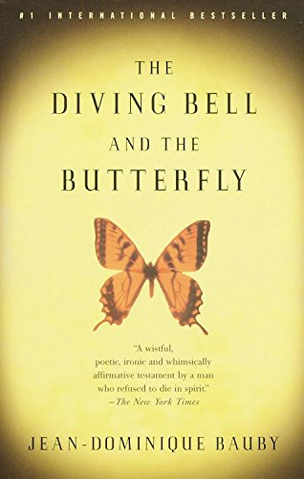
Literature at work
- since 1972, part of MedSchool curricula
- MS program in Narrative Medicine at Columbia
- literary meetings of hospital workers at MGH
- doctor/patient writing a memoir
- connecting with co-sufferers
- healing powers of art
- …

Slide 9
“The practice of medicine is an art, not a trade; a calling, not a business; a calling in which your heart will be exercised equally with your head.”
“Errors in judgment must occur in the practice of an art which consists largely of balancing probabilities.”
“The art of the practice of medicine is to be learned only by experience; ‘tis not an inheritance; it cannot be revealed. Learn to see, learn to hear, learn to feel, learn to smell, and know that by practice alone can you become expert.”
Mark E. Silverman
Deep experience is never peaceful.
Henry James

Slide 10
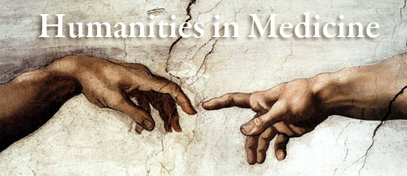
Employment
- health care: hospitals, clinics, nursing and assisted living homes, etc.
- pharmaceutical and biotechnology companies
- academic institutions
- institutional review boards and oversight/compliance boards
- policy organizations and think tanks
- …

Slide 12
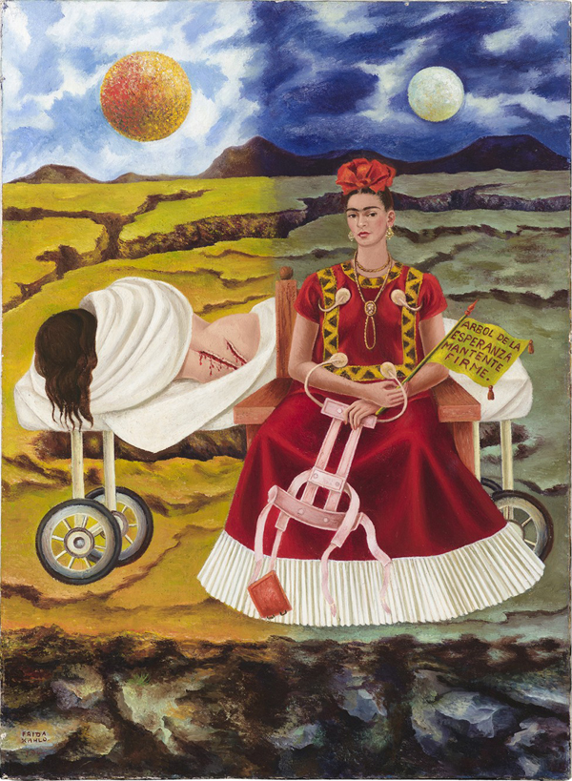
Thank you!
Frida Kahlo, Arbol de la Esperanza (Tree of Hope), 1946.

